Slide 1
Iteration 1
Team OneTen

Slide 2
Introduction
Iteration Overview
User Personas
Project Timeline
Conclusion
Notes:
Daniel Cassandra -> Eugene -> Frank -> Allen
This presentationintends to provide an overview of the first iteration and what will be delivered during the iteration. The overall goal of this project is to deliver a website for Aromy where the customers are able to purchase aromatherapy products and an advanced inventory management system on the administration side, to streamline the business processes and provide a baseline for future growth and expansion.
The main components of this report includes:
An overview of the business requirements that will be delivered in the first iteration
The personas of the users involved in this iteration
A project timeline scheduled with the dates for team meetings and system review
Feedback Notes after the presentation

Slide 3
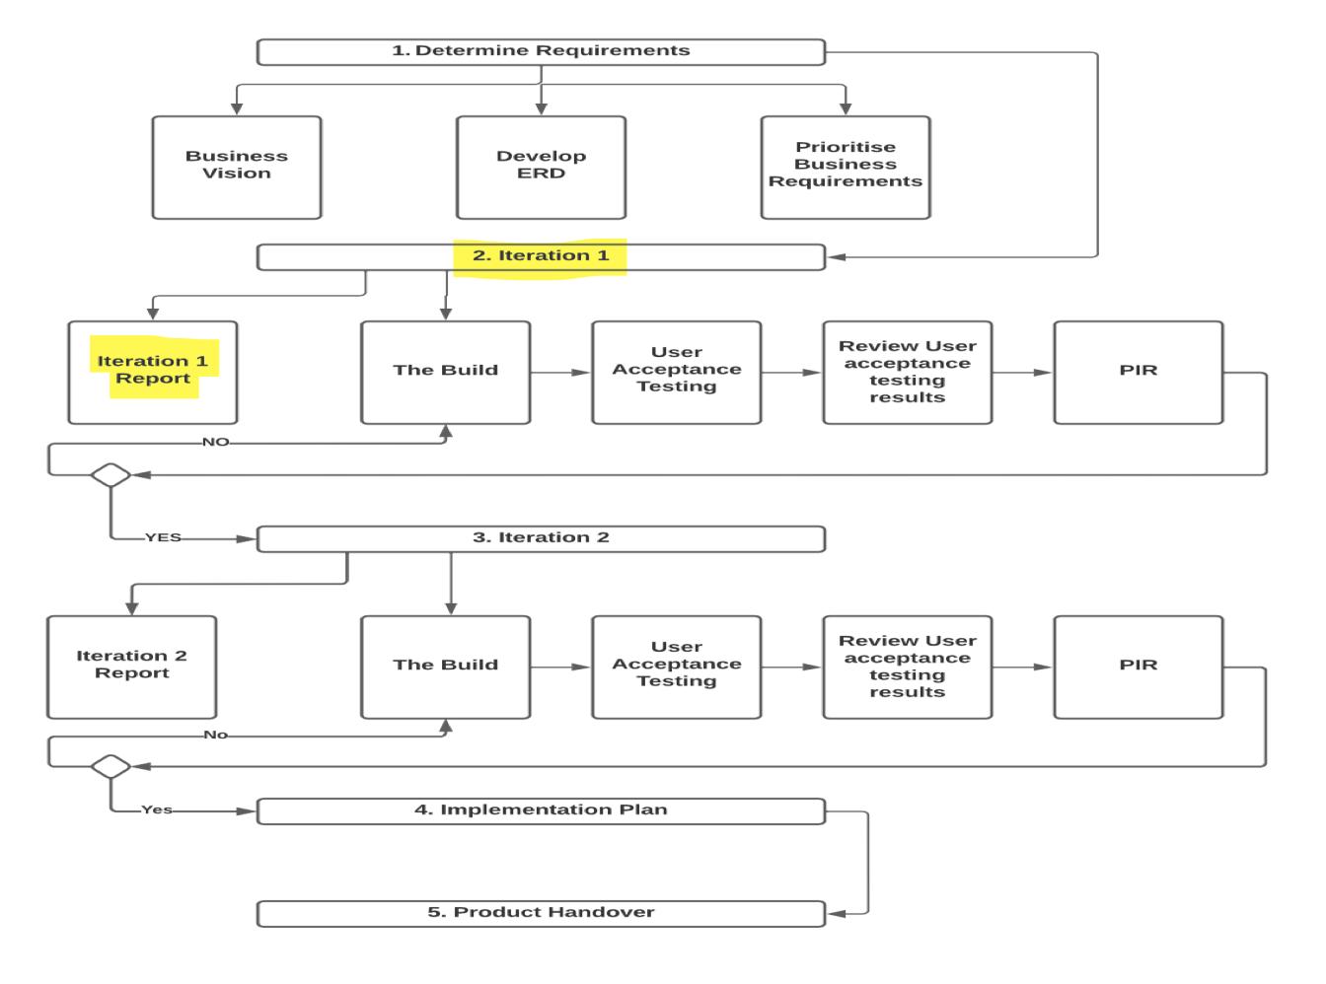
Notes:
Cassandra - An overview of our current stage in this project, we are currently working on iteration 1 and has produced a report for this iteration to be moving forward into the build to work on the business requirements for Aromy

Slide 4
Iteration Overview
Inventory Management System
Reorder report
View, Add, Modify SOH
Order Management System
View, Modify, Delete Order
Update order status
Customer Management System
View customers
Add, modify or delete customers
Notes:
At the end of this iteration we will be delivering an inventory management system, order and the product management systems, where you are able to view, modify and delete on the system

Slide 5


Personas
Personas
Hadywn Fran - 34 years old
Staff : Customer Service Representative for Aromy
Hassle-free order and product editing
No tolerance for poor UI website
Maintain current products
Silas Peppercorn - 52 years old
Staff: Warehouse Manager for Aromy
Needs to learn the new system as quickly as possible
Computer literate but under time to learn a new system may be disruptive to current workflow.
Notes:
Eugene

Slide 6
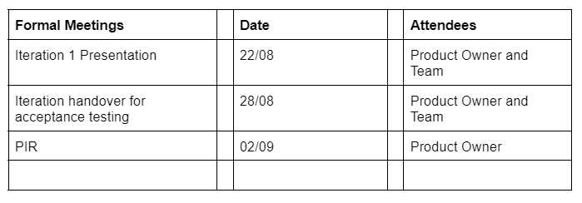
Project Timeline
Notes:
Frank

Slide 7
Thank you
New persona - target on admin/employee
More detail about the Iteration requirement
Iteration 1 process diagram
Notes:
Allan

